Slide 1


Content Analysis for Social Buzz

Slide 2


Agenda
Project recap
Problem
The Analytics team
Process
Insights
Summary

Slide 3

An audit of their big data practice
Recommendations for a successful IPO
An analysis of their content categories that highlights the top 5 categories with the largest aggregate popularity
Project Recap

Slide 4

Problem
Over the past 5 years, Social Buzz has reached over 500 million active users each month. They have scaled quicker than anticipated and need the help of an advisory firm to oversee their scaling process effectively.
Every day over 100,000 pieces of content, ranging from text, images, videos and GIFs are posted. All of this data is highly unstructured and requires extremely sophisticated and expensive technology to manage and maintain

Slide 5



Andrew Fleming (Chief Technical Architect)
The Analytics team
Marcus Rompton (Senior Principle)
Tola Abrahams
(Data Analyst)

Slide 6
Process
1
DATA COLLECTION & MERGING TABLES
2
DATA CLEANING AND FORMATTING
3
DATA ANALYSIS FOR TOP CATEGORIES AND CONTENT
4
VISUALIZATIONS OF TOP CONTENT AND TOP 5 CATEGORIES
5
PRESENTATION OF ANALYSIS AND RESULTS

Slide 7
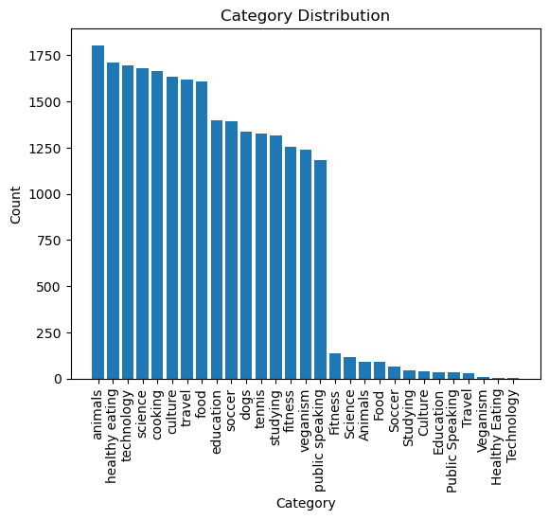

Insights
THE TOP PERFORMING CATEGORIES:
ANIMALS, HEALTHY EATING,TECHNOLOGY, SCIENCE, COOKING
THE LEAST PERFORMING CATEGORIES:
PUBLIC SPEAKING, VEGANISM, FITNESS, STUDYING, TENNIS

Slide 8
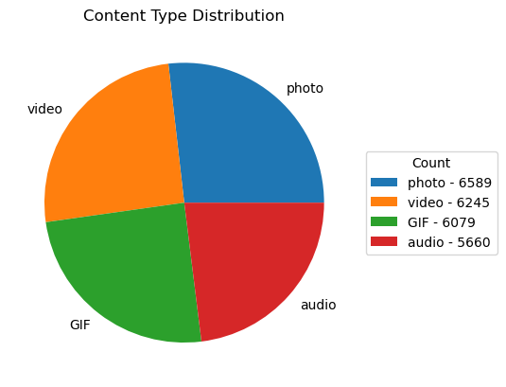
THE MOST ENGAGING CONENTS IS PHOTO
THE LEAST ENGAGING CONENT IS AUDIO

Slide 9
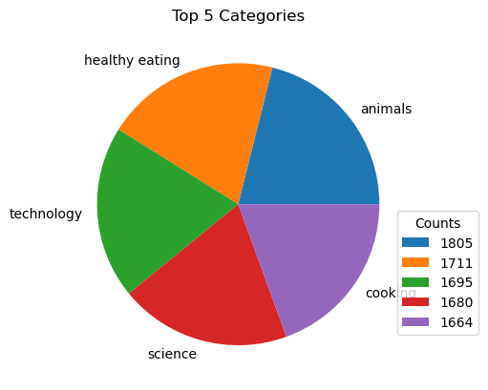
TOP 5 CATEGORIES IN ORDER OF THEIR PERFORMANCE WITH ANIMALS THE MOST AND COOKING LEAST IN THE TOP 5 CATEGORY

Slide 10

THE TOP 5 CATEGORY
ANIMALS = 1805
HEALTHY EATING = 1711
TECHNOLOGY = 1695
SCIENCE = 1680
COOKING = 1664
TOP CONTENT
PHOTO = 6589
VIDEO = 6245
Summary

Slide 11

Thank you!
ANY QUESTIONS?
FIND MORE DETAILS ON THE TASK HERE:
https://github.com/MoAbbazi

